Slide 1
Virtual Reality
Virtual reality is a simulated experience that can be similar to or completely different from the real world. Applications of virtual reality include entertainment, education and business.
The computer-generated simulation of a three-dimensional image or environment that can be interacted with in a seemingly real or physical way by a person using special electronic equipment, such as a helmet with a screen inside or gloves fitted with sensors.

Slide 2
Virtual Reality - XR
Extended Reality (XR) is an umbrella term encapsulating Augmented Reality (AR), Virtual Reality (VR), Mixed Reality (MR), and everything in between.

Slide 3
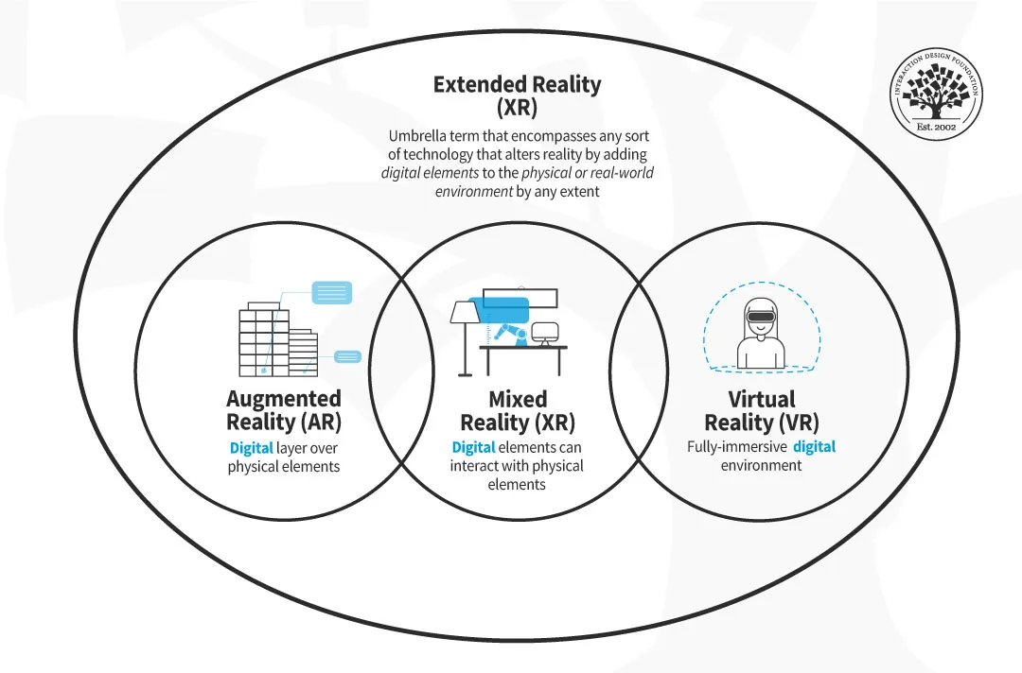

Slide 4
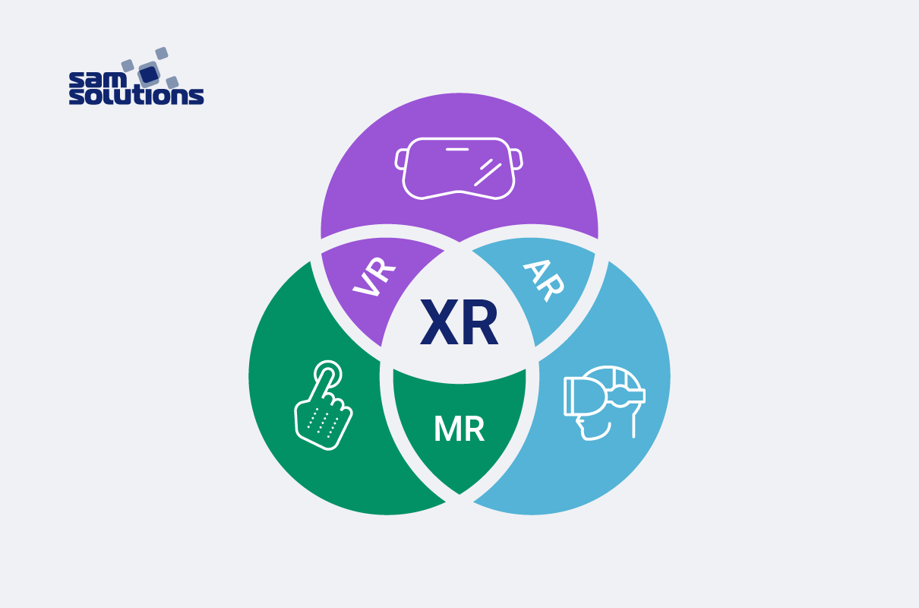
Nowadays, new and emerging technology has nurtured an attachment to acronyms, and virtual reality (VR) as well as augmented reality (AR), mixed reality (MR) and extended reality (XR) are not exceptions. The purpose of what follows will be to clarify what is really behind each of these acronyms. It is important to note that these new technologies come from different places and they seek to do different things. Still, they can use some similar technologies. For example, 3D objects and AI are important to all of them. So let’s look at the concepts and definitions hiding under these words.

Slide 5
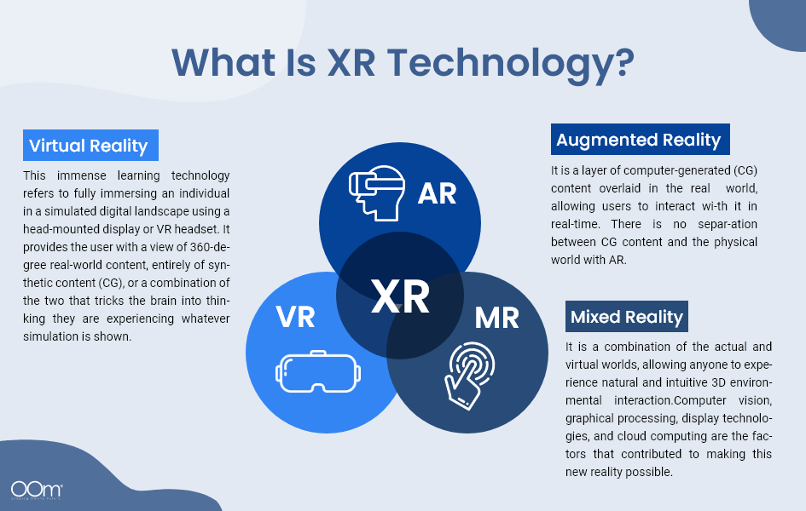
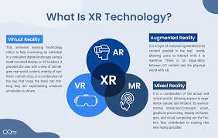

Slide 6
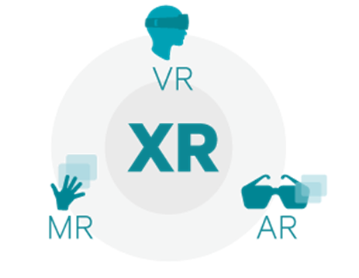
What really is the difference between AR / MR / VR / XR ?

